Slide 1
Relations, operations, structures

Slide 2
Motivation
To evidence memners of some set of objects including its attributes (see relational databases)
For evidence relations between members of some set

Slide 3
Definition
Relation among sets A1,A2,…,An is any subset of cartesian product A1xA2x…xAn.
n-ntuple relation on set A is a subset of cartesian product AxAx…xA.
  Unary relation – attribut of the item
  Binary relation – relation between items

Slide 4
Relation types
Reflexive relation: for any x from A holds x R x
Symetrical relation: for any x,y from A holds: if x R y, then y R x
Transitive relation: for any x,y,z from A holds: if x R y and y R z, then x R z

Slide 5
Relation types
Non symetric relation: there exist at leat one pair x,y from A so that x R y, but not y R x
Antisymetric relation: for any x,y from A holds: if x R y and y R x, then x=y
Asymetric relation: for any x,y from A holds: if x R y, then not y R x

Slide 6
Ralation completness
Complete relation: for any x,y from A either x R y, or y R x
Weakly complete relation: for any different x,y from A either x R y, or y R x

Slide 7
Equivalence
Relation
  Reflexiveí
  Symetrical
  Tranzitive
Divides the set into classes of equivalence

Slide 8
Ordering
quasiordering
  Reflexive
  Tranzitive
Partial ordering
  Reflexive
  Tranzitive
  antisymetrical

Slide 9
Ordering
Weak ordering
  Reflexive
  Tranzitive
  Complete
(complete) ordering
  Reflexive
  Tranzitive
  Antisymetrical
  Complete

Slide 10

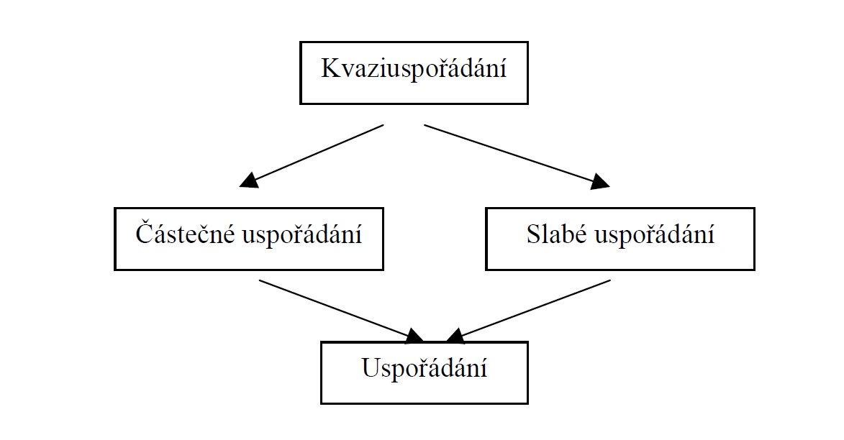
Uspořádání

Slide 11
Crisp ordering
Crisp partial ordering
Crisp weak ordering
crisp (complete) ordering
  Not reflexive

Slide 12
Relation recording
Items enumeration: {(orchidej, orchidej), (orchidej, růže), (orchidej, karafiát), (orchidej, tulipán), (orchidej, fialka), (orchidej, bodlák), (růže, růže), (růže, karafiát), (růže, tulipán), (růže, bodlák), (karafiát, karafiát), (karafiát, bodlák), (tulipán, tulipán), (tulipán, bodlák), (fialka, fialka), (fialka, bodlák), (bodlák, bodlák)}.

Slide 13
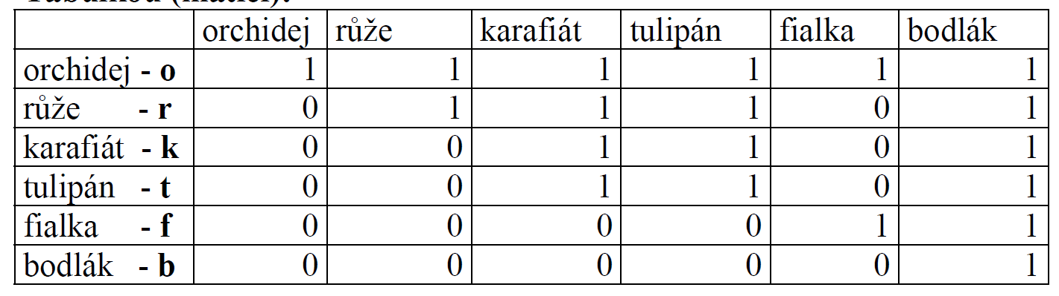
Relation recording
table

Slide 14
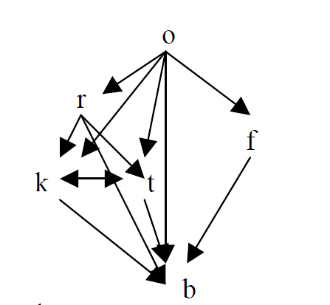
Relation graph

Slide 15
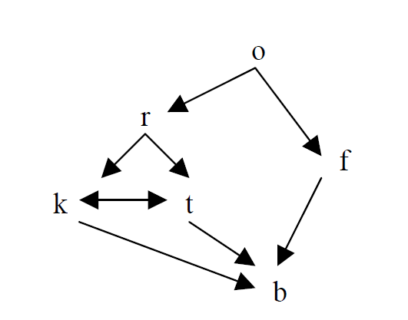
Hasse diagram
Only for transitive relation

Slide 16
Operation
Prescription for 2 or more items to find one result
n-nary operation on the set A is (n+1)-nary relation on the set A so that if (x1,x2,…xn,y) is in the relation and a (x1,x2,…,xn,z) is in the relation then y=z.

Slide 17
Operation -arity
0 (constante)
1 (function)
2 (classical operation)
3 or more

Slide 18
Attributes of binary operations
Complete: for any x,y there exist x ⊕ y
Comutative: x ⊕ y = y ⊕ x
Asociative: (x⊕ y) ⊕ z = x⊕ (y⊕ z)
Neutral item: there exist item ε, so that x⊕ε = ε ⊕ x = x
Inverse items: for any x there exist y, so that x⊕ y = ε

Slide 19
Algebra
Set
Systém of operations
Systém of attributes (axioms), for these operations

Slide 20
Semigroup, monoid
Arbitary set
Operation ⊕
  Semigroup
    Complete
    Asociative
  Monoid
    Complete
    Asociative
    With neutral item

Slide 21
Group
Operation ⊕
  Complete
  Asocoative
  With neutral item
  With inverse items
Abel group
  Comutative

Slide 22

Group examples
Natural numbers and adding
Non zero real numbers and multipling
Permutation of the finite set
Matrices of one size
Moving of Rubiks cube

Slide 23
Ring
Set with 2 operations ⊗ and ⊕
  By the operation ⊕ it is an o Abel group
  Operation ⊗ is complete, comutative, asociate, with neutral item
    Inverse items does not need to exist to the operation ⊗
  distributive: x ⊗(y ⊕ z)=(x ⊗y) ⊕( y ⊗z)
Examples
  Integers and addind, multipling
  Modular classes of integers with the number n.

Slide 24
Division ring
Set T with 2 operation ⊗ and ⊕
  T and ⊕ forms Abel group with neutral item ε
  T-{ε} and ⊗ forms Abel group
In addition to a ring there is a need of existence of the inverse items to ⊗ (it means „posibility of dividing“)
Examples: fractions, real numbers, complex numbers, modular class by dividing with the prime number p, logical operations AND and OR

Slide 25
Lattice
Set S with 2 operations ∨ (union) and ∧ (intersect)
  ∨ and ∧ are comutative and asociative
  Holds distributive rules
    a ∨ (b ∧ c) = (a ∨ b) ∧ (a ∨ c)
    a ∧ (b ∨ c) = (a ∧ b) ∨ (a ∧ c)
  Absorbtion: a ∧(b ∨ a)=a, a ∨(b ∧ a)=a
  Idenpotence a ∨ a = a, a ∧ a = a
Examples
  Propositional calculus and logical operators AND and OR
  Subsets of given set and operations of union and intersection
  Members of partialy ordered set and operations of supremum and infimum.

